Slide 1
Traveling Salesman Problem
Simon Have & Jesper Bækdahl
hyggekaffe.dk

Slide 2
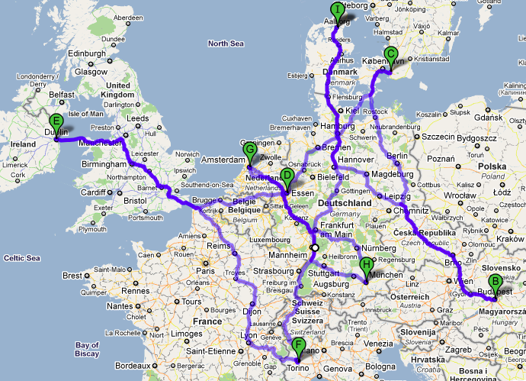
Problem
Find shortest path between cities given their pairwise distance
Most intensive problems studied in optimization

Slide 3
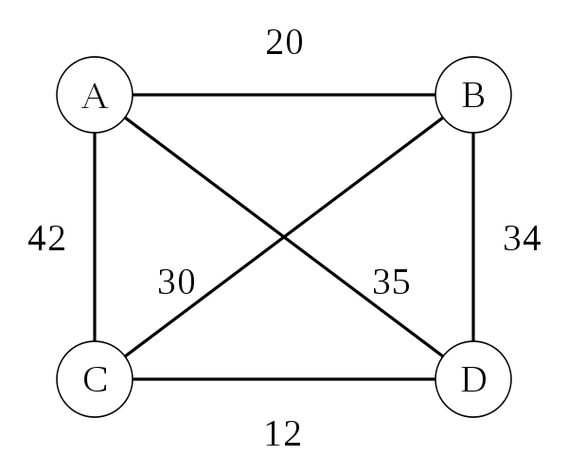
Graph problem
Vertices: cities
Equivilent: Find a Hamiltonian cycle with least total distance
Complexity O(n!)
Notes:
Hamiltonian cycle visits each vertex exactly once and returns to start vertex

